Slide 1


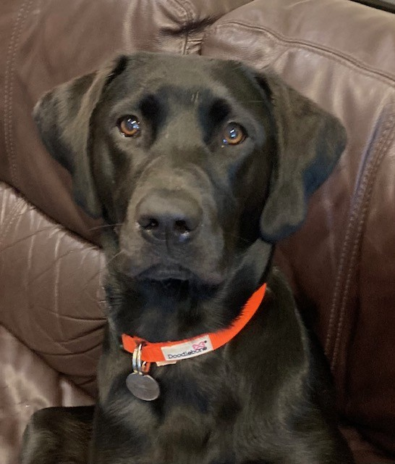
WELCOME
Milo
OUR

Slide 2

Hi, my name is Milo, and I am your dog mentor. I am here to help you every day in lots of different ways. Most importantly I'm here to be your friend. There are lots of ways that you can help me to be happy and safe in school...

Slide 3
working with the dog mentor
  There should be no more than two people around me at a time
  Always ask before stroking me
  If given permission to stroke me, you must lower yourself to the ground
  Stroke me from the chest or shoulder down to the tail
  Never reach over the top of my head
  You should not ruffle my fur

Slide 4
playground
  When approaching me, try not to shout or be over-excited as I may get scared
  No running towards me
  Never stroke me when standing behind me
  If you are playing with a ball, try to keep the ball from travelling in my direction
  I don't like it when people crowd around me - always ask permission to approach

Slide 5
moving around the school
  Always walk around the school sensibly
  Don't reach out to touch me when I'm passing
  Use indoor voices
  Try to keep my name inside your head rather than shout it out
  You may see me walking around the school with Mrs Gibbons or Mr Wakefield

Slide 6
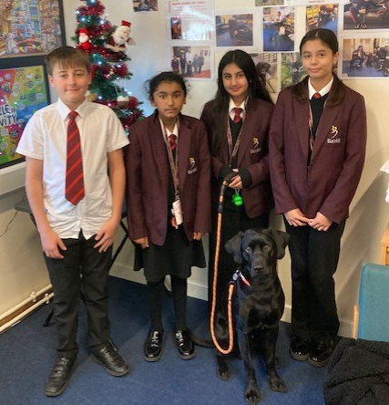
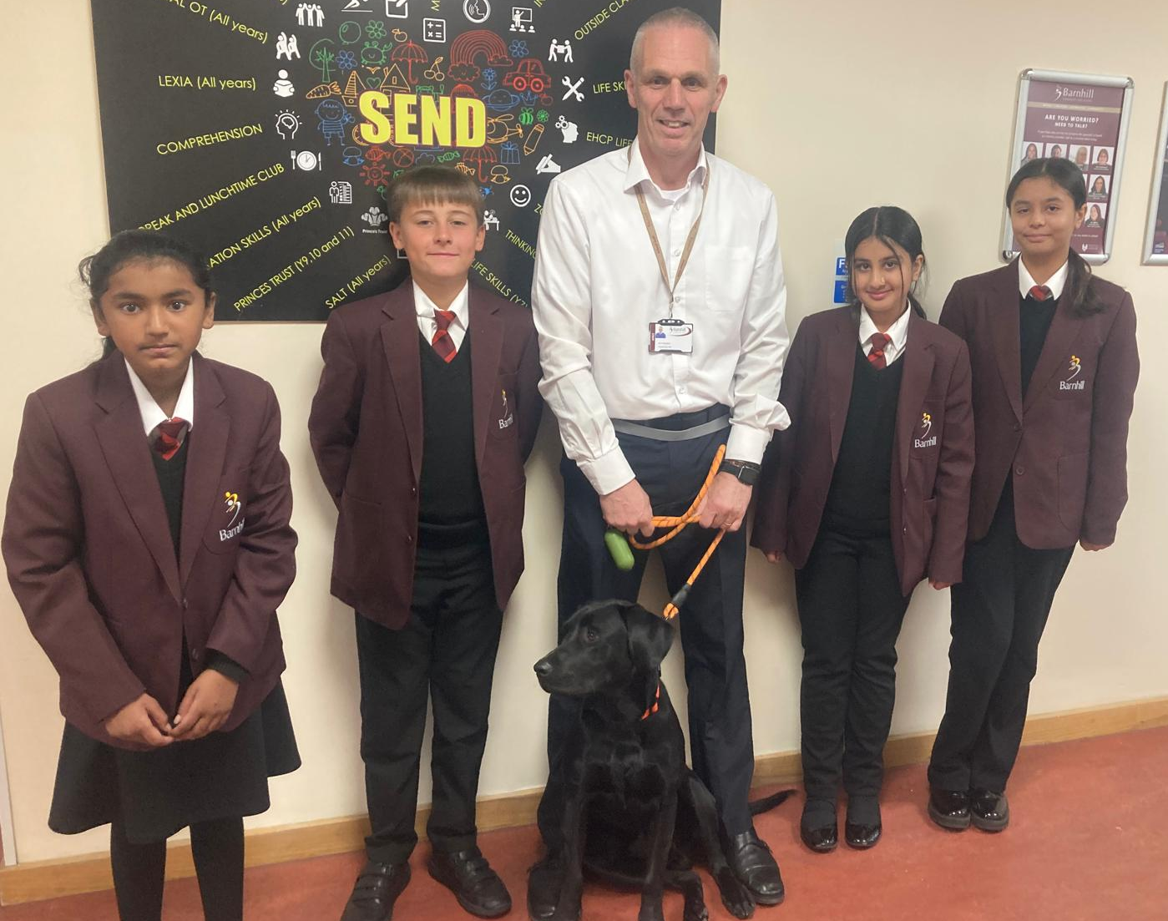
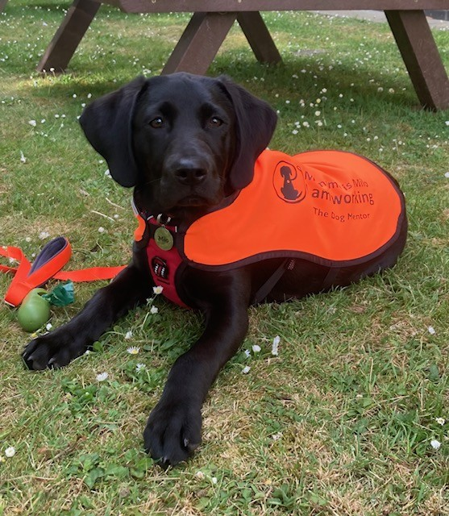
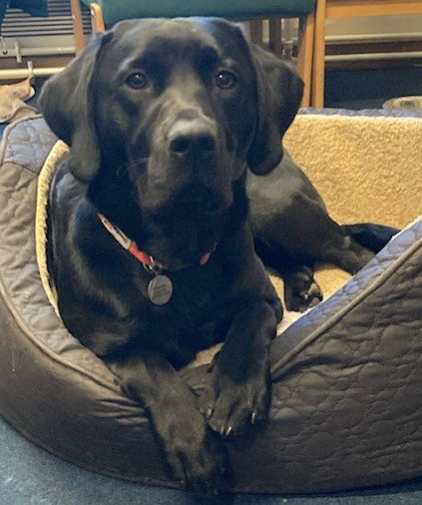

I can’t wait to work with you all
Best wishes
Milo

